Slide 1

PYTHON ANALYSIS
Analysis of Diabetes and Medical Indicators Impact on Patient Length of Stay
July 2024 | Sadia Ayoub

Slide 2

Topics for discussion
Agenda
Introduction
Motivation
Data Source
Data Cleaning and Transformations
Statistical Analysis
Data Visualization
Conclusion
Q&A
July 2024 | Sadia Ayoubt

Slide 3

Introduction
The project aims to analyze how diabetes and other medical indicators impact patient length of stay within hospitals
July 2024 | Sadia Ayoub

Slide 4

Motivation
Why i choose this data set for data analysis?
July 2024 | Sadia Ayoub

Slide 5

Data Source
Dataset: Diabetes 130-US hospitals for years 1999-2008.
Contains 50 columns including patient demographics, medical conditions, medications, and hospital stay details.
Publicly available from UCI Machine Learning Repository.
July 2024 | Sadia Ayoub

Slide 6

Data Cleaning and Transformations
Handled missing values by replacing '?' with NA.
Converted columns to appropriate data types (e.g., age, time_in_hospital).
Removed duplicates to ensure data quality.
Verified the cleaning steps to confirm data readiness for analysis.
July 2024 | Sadia Ayoub

Slide 7

Descriptive Statistics
Calculated descriptive statistics for patients with and without diabetes.
Patients with diabetes have longer hospital stays compared to those without diabetes.
Key Statistics:
Patients with Diabetes: Mean stay = X days, Median stay = Y days
Patients without Diabetes: Mean stay = A days, Median stay = B days
July 2024 | Sadia Ayoub

Slide 8

Statistical Analysis
Conducted a t-test to compare the lengths of stay between patients with and without diabetes.
Result:
T-statistic: X
P-value: Y
The difference in hospital stay lengths is statistically significant.
July 2024 | Sadia Ayoub

Slide 9

Data Visualization
Scatter Plot
Heatmap
Box Plot
Bar Plot
Line Plot
Bar Plot by Age Group
July 2024 | Sadia Ayoub

Slide 10
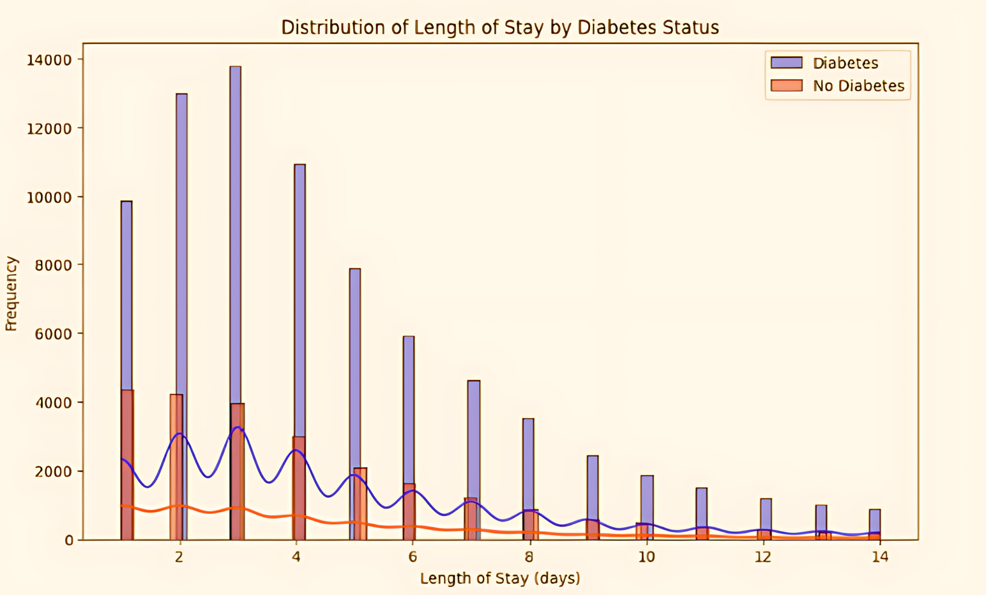
Scatter Plot
Scatter plot shows the relationship between patient age and length of stay.
Patients with diabetes tend to have longer stays, especially in older age groups(as shown in figure).
January 2022 | Project Report

Slide 11
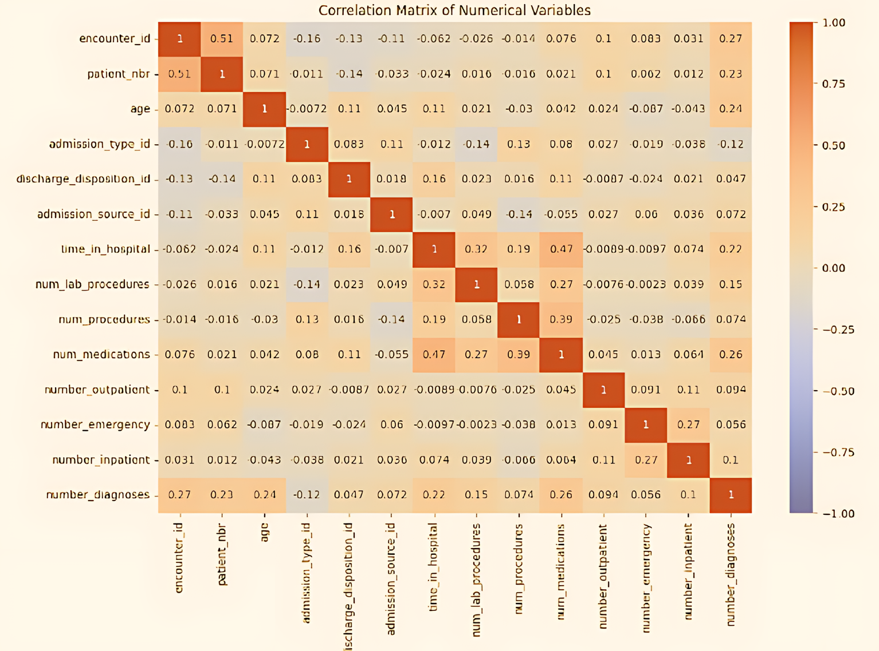
Heatmap
Heatmap visualizes correlations between numerical variables.
Highlights relationships between different factors and patient length of stay.
January 2022 | Project Report

Slide 12
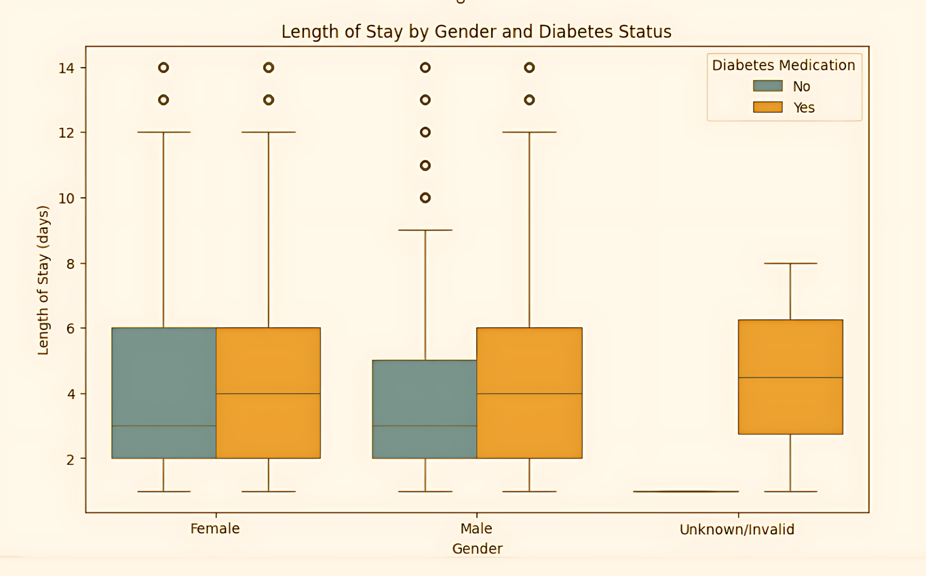
Box Plot
Box plot compares the length of stay between male and female patients.
Shows that both genders have longer stays if they have diabetes.
January 2022 | Project Report

Slide 13
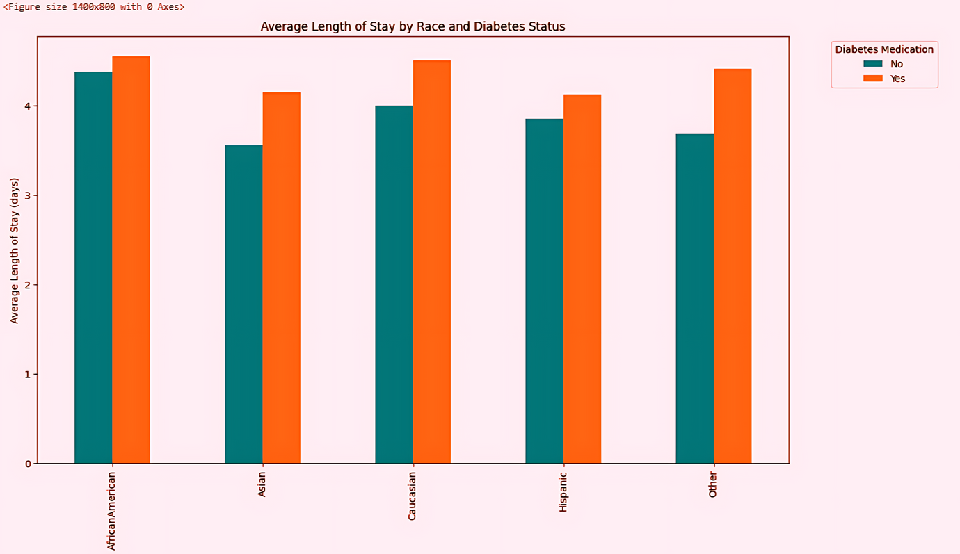
Bar Plot
Bar plot shows the average length of stay for different racial groups.
Racial disparities in hospital stays are evident, with certain groups having longer stays.
January 2022 | Project Report

Slide 14

Conclusion
Patients with diabetes tend to have significantly longer hospital stays.
Age, race, and number of procedures also impact hospital stay duration.
Insights can help healthcare providers develop targeted interventions to improve patient outcomes and hospital efficiency.
January 2022 | Project Report

Slide 15

Any Questions!

Slide 16

Thank you

